Slide 1
RED WINE ANALYSIS --- KRUSHAB GANDHI
Team: Teetotalers
Course: ALY6040 Data Mining Applications
Professor Name: Mr. Sergiy Shevchenko
Northeastern University

Slide 2
INTRODUCTION
The aim of our project is to perform exploratory analysis of wine data, and determine which chemical properties influence the quality of wine.
We will explore the analysis in the following phases:
1. Univariate Analysis
2. Bivariate Analysis
3. Multivariate Analysis
4. Predictive models(Linear model and Support Vector Machine)
5. Conclusion

Slide 3
DATASET DESCRIPTION
Attributes | Description
fixed acidity | most acids involved with wine or fixed or nonvolatile (do not evaporate readily)
volatile acidity | the amount of acetic acid in wine, which at too high of levels can lead to an unpleasant, vinegar taste
citric acid | found in small quantities, citric acid can add 'freshness' and flavor to wines
residual sugar | the amount of sugar remaining after fermentation stops, it's rare to find wines with less than 1 gram/liter and wines with greater than 45 grams/liter are considered sweet
chlorides | the amount of salt in the wine
free sulfur dioxide | the free form of SO2 exists in equilibrium between molecular SO2 (as a dissolved gas) and bisulfite ion; it prevents microbial growth and the oxidation of wine
total sulfur dioxide | amount of free and bound forms of S02; in low concentrations, SO2 is mostly undetectable in wine, but at free SO2 concentrations over 50 ppm, SO2 becomes evident in the nose and taste of wine
density | the density of water is close to that of water depending on the percent alcohol and sugar content
pH | describes how acidic or basic a wine is on a scale from 0 (very acidic) to 14 (very basic); most wines are between 3-4 on the pH scale
sulphates | a wine additive which can contribute to sulfur dioxide gas (S02) levels, which acts as an antimicrobial and antioxidant
alcohol | the percent alcohol content of the wine
quality | score between 0 and 10 (10 being the highest)

Slide 4
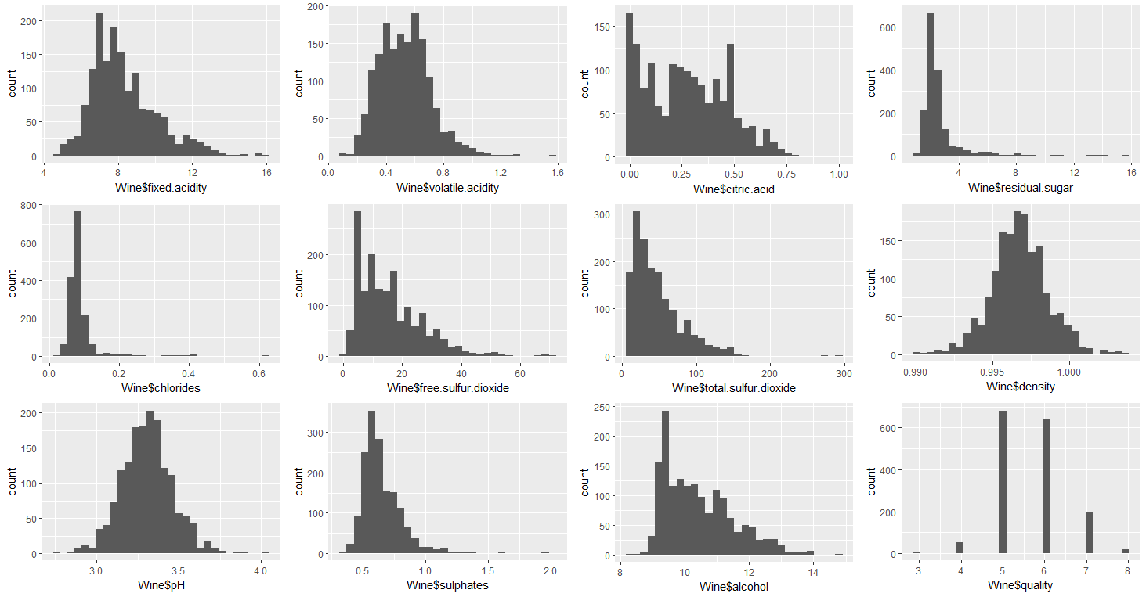
UNIVARIATE ANALYSIS
‘quality’ variable forms a normal distribution
Density and pH are normally distributed with a few outliers
Fixed and volatile acidity, sulfur dioxides, sulphates, and alcohol are skewed
Qualitatively, residual sugar and chlorides have extreme outliers.
Citric acid has large number of zero values, which might be a case of non-reporting.
To explore further, we created two new variables: TAC.acidity and Rating

Slide 5
UNIVARIATE ANALYSIS
Proving that citric acid has a lot of non-reporting values

Slide 6
UNIVARIATE ANALYSIS
Extreme outliers present in residual sugar, chlorides and sulphates

Slide 7
UNIVARIATE ANALYSIS
Using Boxplots to visualize the outliers

Slide 8
BIVARIATE ANALYSIS
Visualizing each variable against quality

Slide 9
BIVARIATE ANALYSIS
Visualizing each variable against rating

Slide 10
BIVARIATE ANALYSIS
Conclusions drawn from Bivariate Analysis
From the plots we come to know that a ‘good wine’ has the following trends:
Higher fixed acidity (tartaric acid) and citric acid
Lower volatile acidity (acetic acid)
Lower pH (i.e. more acidic)
Higher sulphates and alcohol
To a lesser extent, lower chlorides and lower density
Residual sugar and sulphur dioxides has no effect
Different categories of acids affect wine quality differently; viz. TAC.acidity saw an attenuated trend as the presence of volatile acetic acid decreased quality

Slide 11
BIVARIATE ANALYSIS
The top 4 most influencing variables having the highest correlations against quality are:
alcohol
sulphates (log10)
volatile acidity
citric acid
Let’s visualize them against each other using RATING as a facet.

Slide 12
BIVARIATE ANALYSIS
citric.acid and alcohol, sulphates and alcohol, volatile.acidity and alcohol using Rating as a facet

Slide 13
BIVARIATE ANALYSIS
Using
Rating
as a
Facet
citric.acid and alcohol
volatile.acidity and sulphates
citric.acid and volatile.acidity
citric.acid and sulphates

Slide 14
BIVARIATE ANALYSIS
Conclusions drawn from the plots:
The plots were nearly uniformly-distributed
The weakest bivariate relationship appeared to be between alcohol vs. citric acid
The strongest relationship appeared to be volatile acidity vs. citric acid, which had a negative correlation
Most notably, base 10 logarithm TAC.acidity correlated very well with pH. This is certainly expected, as pH is essentially a measure of acidity.
Question: An interesting question to pose, using basic chemistry knowledge, is to ask what other components other than the measured acids are affecting pH?
Answer: We can quantify this difference by building a predictive linear model, to predict pH based on TAC.acidity and capture the % difference as a new variable.

Slide 15
PREDICTIVE MODELS: SUMMARY
Linear Model and Support Vector Machine
Based on RMSE values, SVM(0.1067) functions slightly better than a LM(0.1095)
The median % error hovered at or near zero for most wine qualities. Notably, wines rated with a quality of 3 had large negative error.
We can interpret this finding by saying that for many of the 'bad' wines, total acidity from tartaric, acetic, and citric acids were a worse predictor of pH.
In simple words, it is likely that there were other components--possibly impurities--that changed and affected the pH.

Slide 16
Multivariate ANALYSIS
We primarily examined the 4 features which showed high correlation with quality.
We faceted by rating in the final plot to illustrate clearly and a little more about the population differences between good wines, average wines, and bad wines.
It's clear that a higher citric acid and lower volatile (acetic) acid contributes towards better wines.
Likewise, better wines tended to have higher sulphates and alcohol content.
Surprisingly, pH had very little visual impact on wine quality, and was shadowed by the larger impact of alcohol. Interestingly, this shows that what makes a good wine depends on the type of acids that are present.

Slide 17
CONCLUSION
Generally, higher acidity (or lower pH) is seen in highly-rated wines. To caveat this, a presence of volatile (acetic) acid negatively affected wine quality. Citric acidity had a high correlation with wine quality, while fixed (tartaric) acid had a smaller impact.

Slide 18
CONCLUSION
Higher alcohol content correlated with higher wine quality. However, as the outliers and intervals show, alcohol content alone did not produce a higher quality

Slide 19
CONCLUSION
From the correlation tests, we came to know that wine quality was affected most strongly by alcohol and volatile acidity.
While the boundaries are not as clear cut or model, it's apparent that high volatile acidity with few exceptions kept wine quality down. A combination of high alcohol content and low volatile acidity produced better wines.

Slide 20
CONCLUSION
Key factors that determine and drive wine quality are mainly: alcohol content, sulphates, and acidity as the correlations for these variables were within reasonable bounds.
The graphs adequately illustrated the factors that make good wines 'good' and bad wines 'bad’.
Further study with inferential statistics could be done to quantitatively confirm these assertions.
One of the challenges that we faced was the lack of a clear analysis about the quality of our wine.
The ordered factor "Quality" was not very helpful and to overcome this, we created another variable "Rating".
To make predictions of wine quality and any other if required, we trained two models. Linear Model and SVM performed marginally better and we decided to stick with it if we had to make any more predictions.

Slide 21
Cheers !

